Slide 1


Safeguarding Government Data in Cloud
A Framework for Protecting Cloud Systems with SSAE 16 Type II, ISO 27001 & Major Cloud Providers.
Presenter: Syed Ammar Hussain
Diploma: EduQual RQF Level 3
Date: 13 – September - 2025

Slide 2


Safeguarding Government Data in Cloud
Introduction
Assurance
Implement
Conclusion
Introduction
Governance
Securing Sensitive Data in the Cloud:
The objective is to secure government data in the cloud.
Protection of this data is a national security imperative.
We'll explore a layered approach: governance, assurance, and technical controls.
This strategy protects data and builds trust.
This presentation will guide you through this holistic security model.
A Framework for Protecting Cloud Systems with SSAE 16 Type II, ISO 27001 & Major Cloud Providers.
Presenter: Syed Ammar Hussain
Diploma: EduQual RQF Level 3
Date: 13 – September - 2025

Slide 3
Introduction
Assurance
Implement
Conclusion
Introduction
Governance
Securing Sensitive Data in the Cloud:
The objective is to secure government data in the cloud.
Protection of this data is a national security imperative.
We'll explore a layered approach: governance, assurance, and technical controls.
This strategy protects data and builds trust.
This presentation will guide you through this holistic security model.

Slide 4
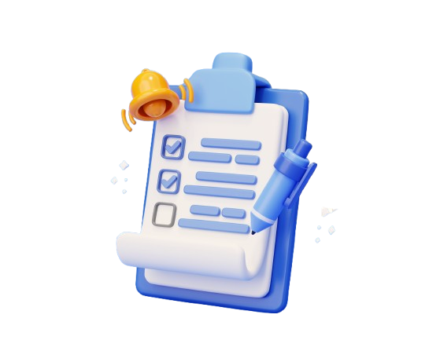

What is SSAE 16 Type II?
Assurance
Introduction
Assurance
Governance
Implement
Conclusion
An auditing standard for service organizations by AICPA.
It is an attestation standard and applies only to SOC-1 reports.
The primary focus is on controls over financial reporting (ICFR).
A Type II report attests to the operational effectiveness of controls.
These reports are critical for financial auditors.

Slide 5


From SSAE 16 to SSAE 18:
Assurance
Introduction
Assurance
Governance
Implement
Conclusion
SSAE 18 succeeded SSAE 16 with a broader scope.
It places greater emphasis on monitoring sub-service organizations.
The standard enhances the value of the report for due diligence.
It aligns more closely with other international standards.
This makes SSAE 18 a more robust and relevant standard for government agencies.

Slide 6


The Benefit of SSAE 16 Type II:
Assurance
Introduction
Assurance
Governance
Implement
Conclusion
A SOC 1 Type II report provides a critical layer of assurance.
It reduces the audit burden on the government agency's own auditors.
The report enhances trust and credibility in the cloud provider.
This assurance confirms that financial data is handled with due care.
However, it does not provide comprehensive security assurance for the entire environment.

Slide 7


The ISO 27001 Framework:
Introduction
Assurance
Governance
Implement
Conclusion
Governance
ISO 27001 is the international standard for an Information Security Management System (ISMS).
It provides a systematic framework for information security.
The framework is based on a Plan-Do-Check-Act (PDCA) cycle.
ISO 27002 provides the companion guidance on control implementation.
This is a risk-based, rather than a checklist, approach to security.

Slide 8


A Risk-Driven Approach:
Introduction
Assurance
Governance
Implement
Conclusion
Governance
ISO 27001 requires a comprehensive risk management process.
This process includes risk identification, analysis, and evaluation.
It mandates a structured approach to treating or mitigating identified risks.
This approach aligns security decisions with the organization's business objectives.
The process culminates in a Statement of Applicability (SoA) document.

Slide 9


The Value of ISO 27001:
Introduction
Assurance
Governance
Implement
Conclusion
Governance
ISO 27001 certification proves an operational and auditable ISMS.
It provides assurance in the overall security posture "of the cloud.“
This certification adds another layer of trust and credibility for the agency.
The Statement of Applicability is a key document for review.
But it does not specify the technical tools for implementing controls.

Slide 10


Cloud-Native Security Tools:
Assurance
Implement
Introduction
Governance
Tools
Conclusion
Cloud-native tools fulfill the Shared Responsibility Model.
They are utilized to establish security in the cloud environment.
GCP Security Command Center provides Cloud Security Posture Management (CSPM).
Microsoft Defender for Cloud offers both CSPM and Cloud Workload Protection (CWP).
These tools create data silos, lacking a unified view across platforms.

Slide 11

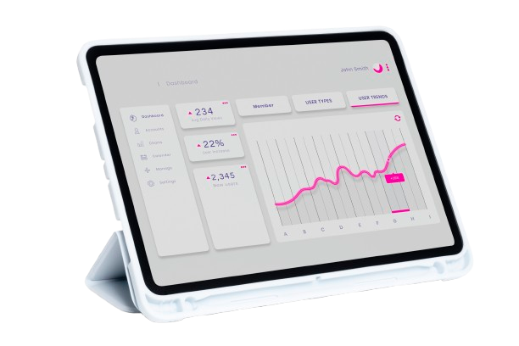
SIEM and Centralized Logging:
Assurance
Implement
Introduction
Governance
Tools
Conclusion
A SIEM provides a centralized platform for security intelligence.
Wazuh is a powerful open-source SIEM with Host IDS and FIM capabilities.
It provides a centralized platform for aggregating and correlating logs.
This provides a single, customizable view of the entire security posture.
The SIEM enables real-time threat detection and incident response.

Slide 12
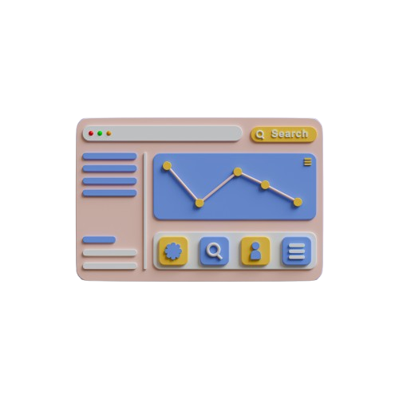

Tools in Practice:
Assurance
Implement
Introduction
Governance
Tools
Conclusion
Cloud-native tools implement controls from our ISMS.
They generate a constant stream of security telemetry and logs.
A SIEM aggregates data from all platforms into a single view.
This provides the visibility required for real-time monitoring and incident response.
This technical layer proves the operational effectiveness of our security program.

Slide 13
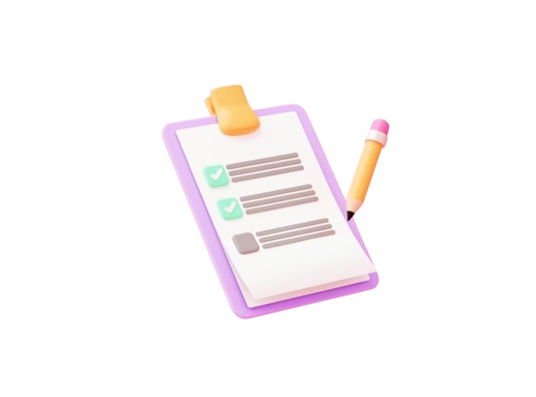

Summary and Final Thought:
Assurance
Implement
Conclusion
Introduction
Governance
Conclusion
Securing government data requires a robust, layered defense.
This defense begins with the assurance of standards like SSAE 16/18.
It is then guided by the comprehensive governance of ISO 27001.
The strategy is implemented and measured using cloud-native and SIEM tools.
Ultimately, this holistic model builds a foundation of trust and resilience.

Slide 14
"Security is not a product, but a process."
— Bruce Schneier
Thank You.

